Slide 1

45 Day Check-in
GO Team Meeting #3
Tonetta Green, Principal
Herman J. Russell West End Academy

Slide 2
Agenda
CIP-45 Day Check-in
Fall ACES Presentation
School Strategic Plan
Discussion on Strategic Plan and progress
Updates for Strategic Plan (as necessary)
Preparing for the Budget Development
Rank Strategic Priorities

Slide 3
Timeline for GO Teams
You are HERE
1
2
3
4
5
1
2
3
4
5
Fall 2021
GO Team Developed 2021-2025 Strategic Plan
Summer 2022
School Leadership completed Needs Assessment and defined overarching needs for SY22-23
August 2022
School Leadership completed 2022-2023 Continuous Improvement Plan
Sept. – Dec. 2022
Utilizing current data, the GO Team will review & possibly update the school strategic priorities and plan
Before Winter Break
GO Team will take action (vote) on the school’s strategic plan and vote on the ranked strategic plan priorities for SY23-24 budget discussions.

Slide 4
Quarterly CIP Check-in
As part of the Continuous Improvement process, all APS schools are completing a quarterly check-in for the Continuous Improvement Plans.
Questions to Consider
Based on our year long CIP plan, what are the actions that the school has already completed?​
What data supports the completion of an action step and success criteria (both implementation and student achievement)?

Slide 5
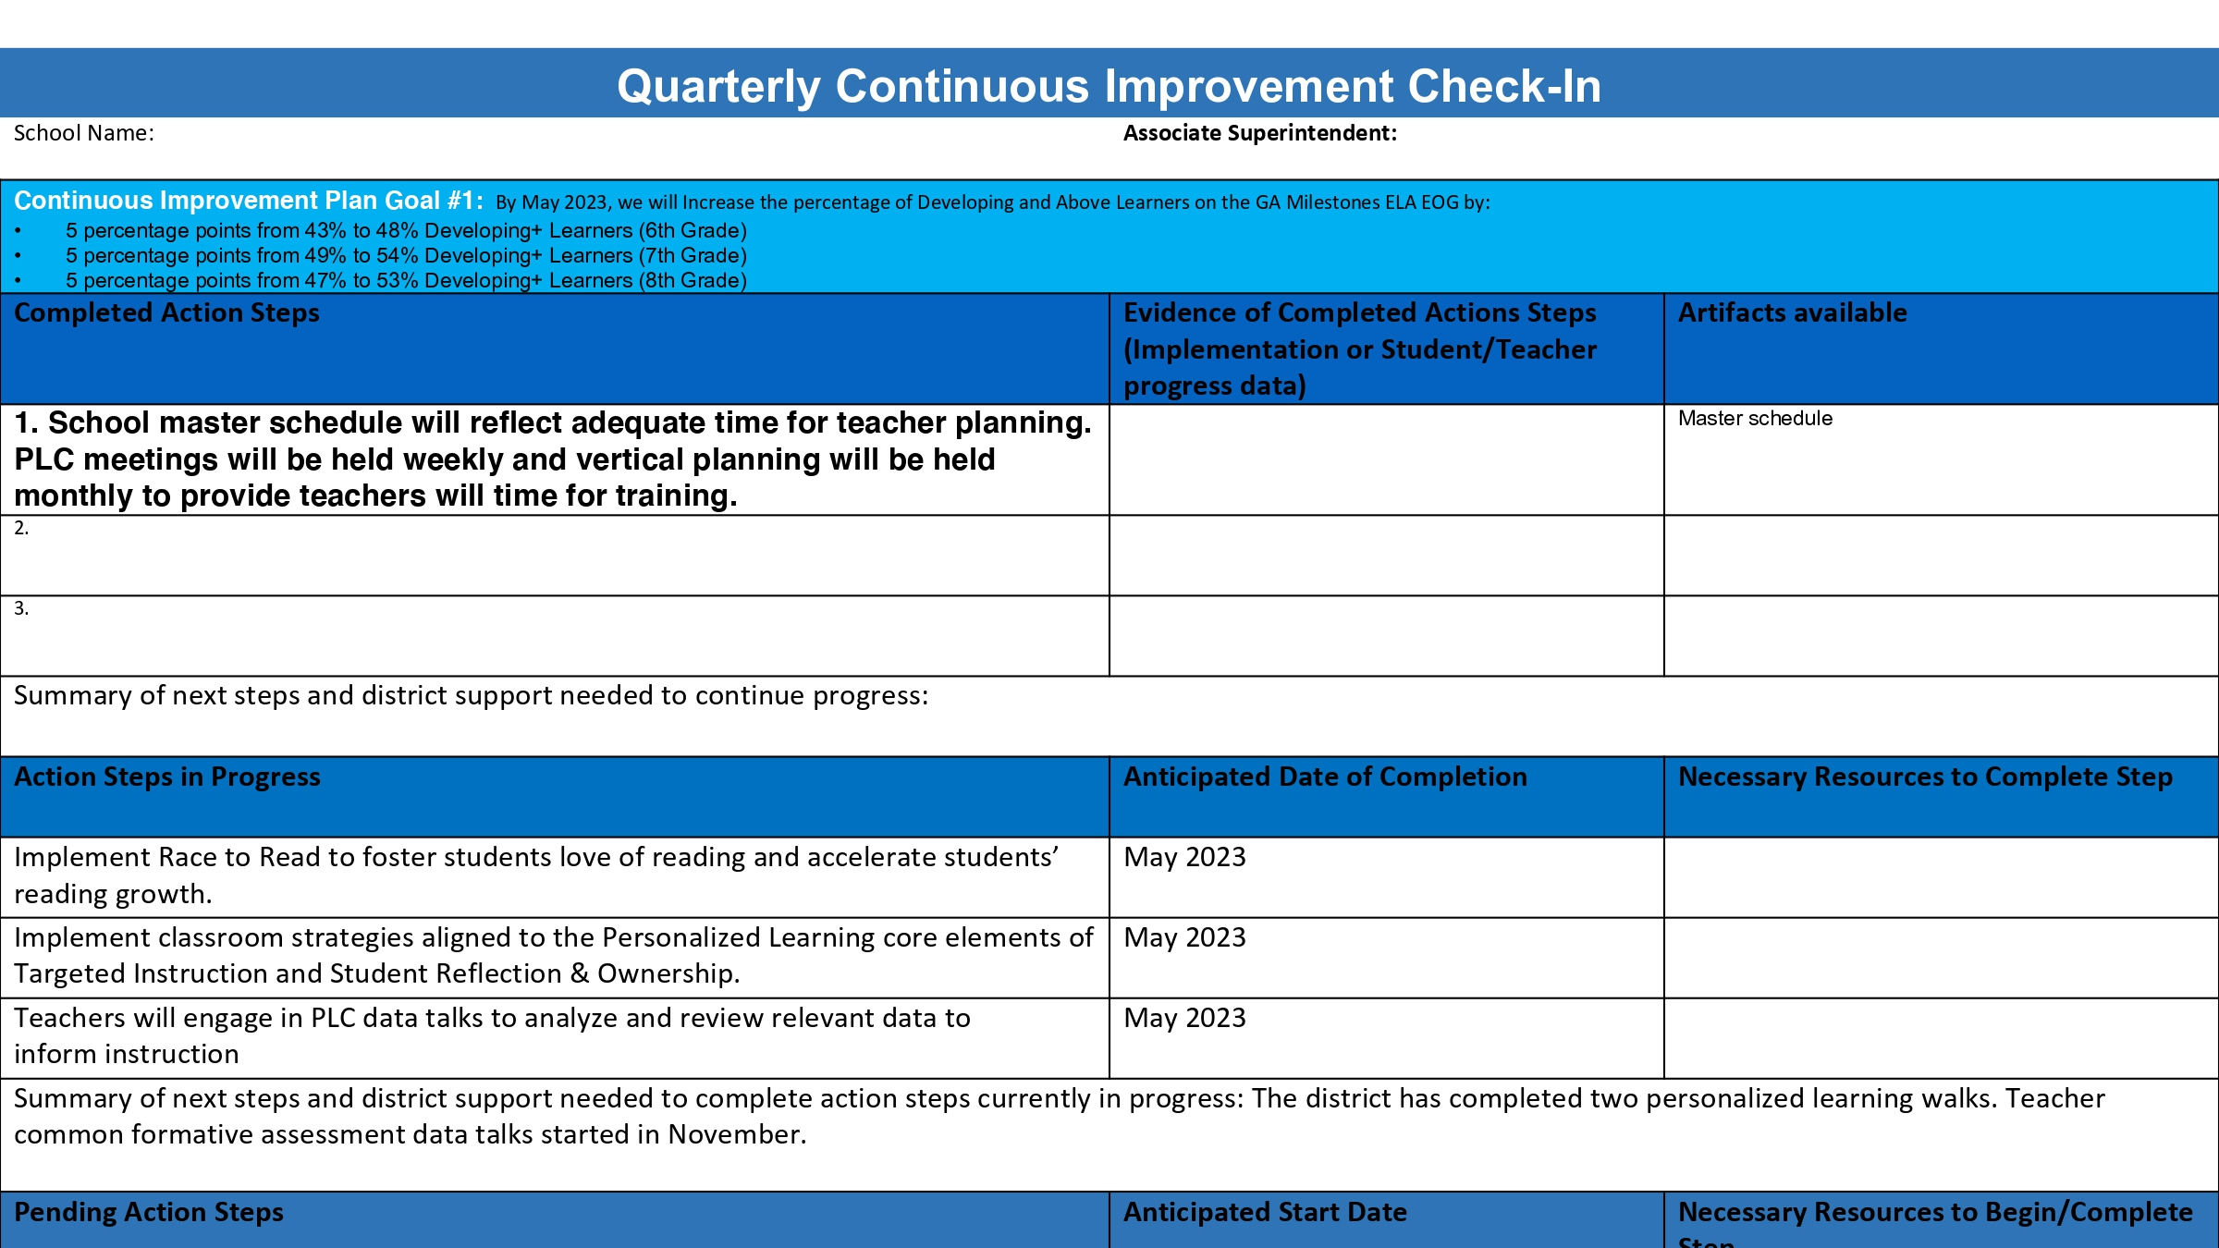

Slide 6
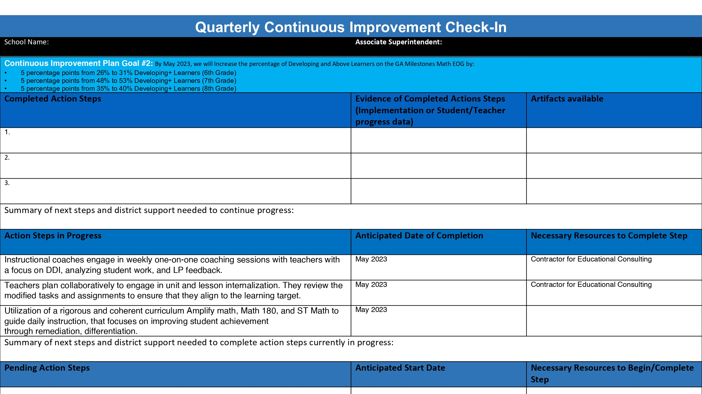

Slide 7
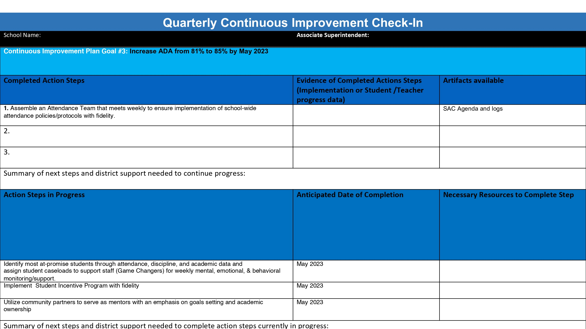

Slide 8

Accountability
Collaboration
Equity
Support
Fall 2022 ACES Presentation

Slide 9
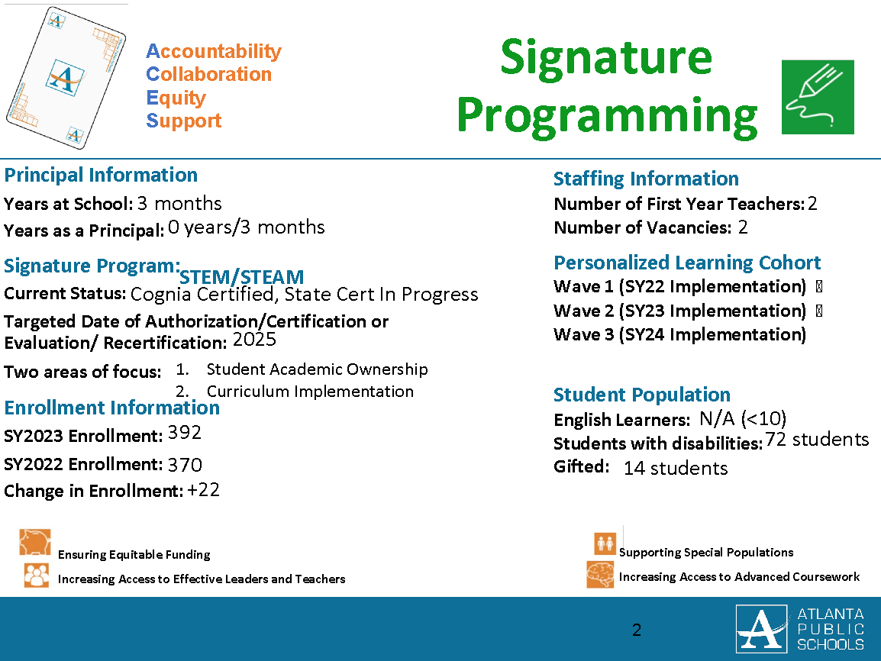

Slide 10
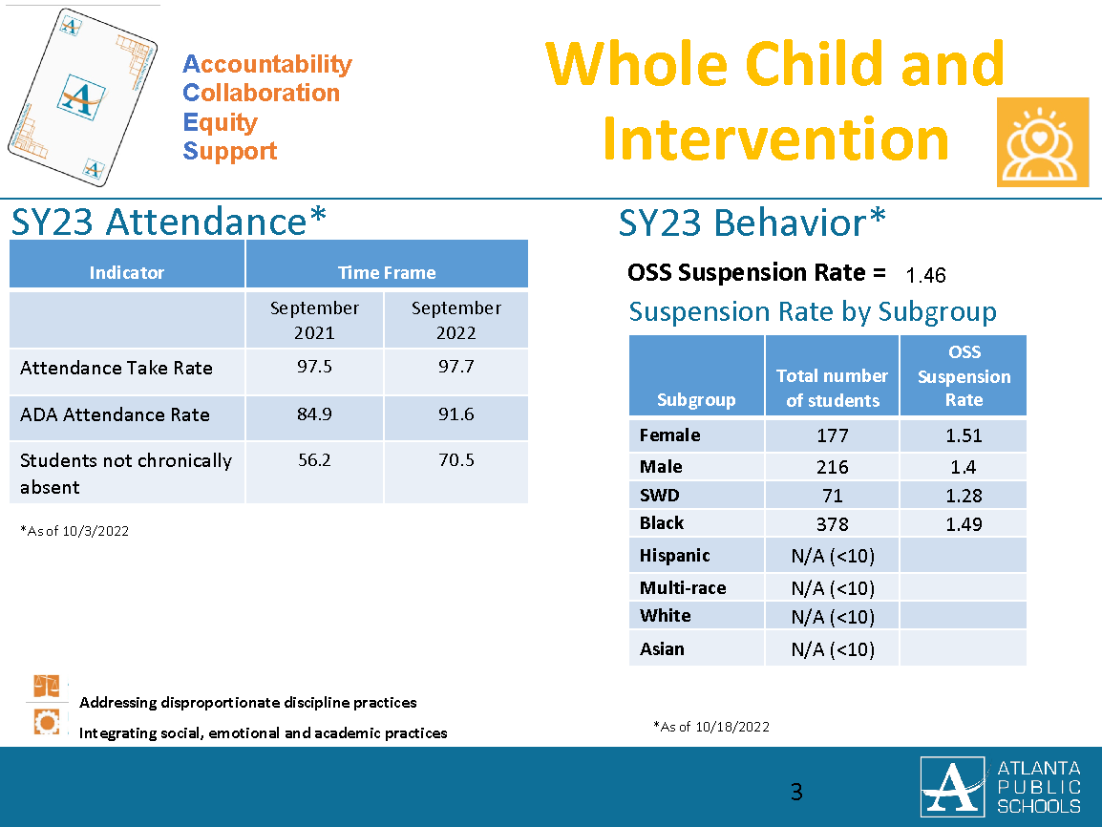

Slide 11
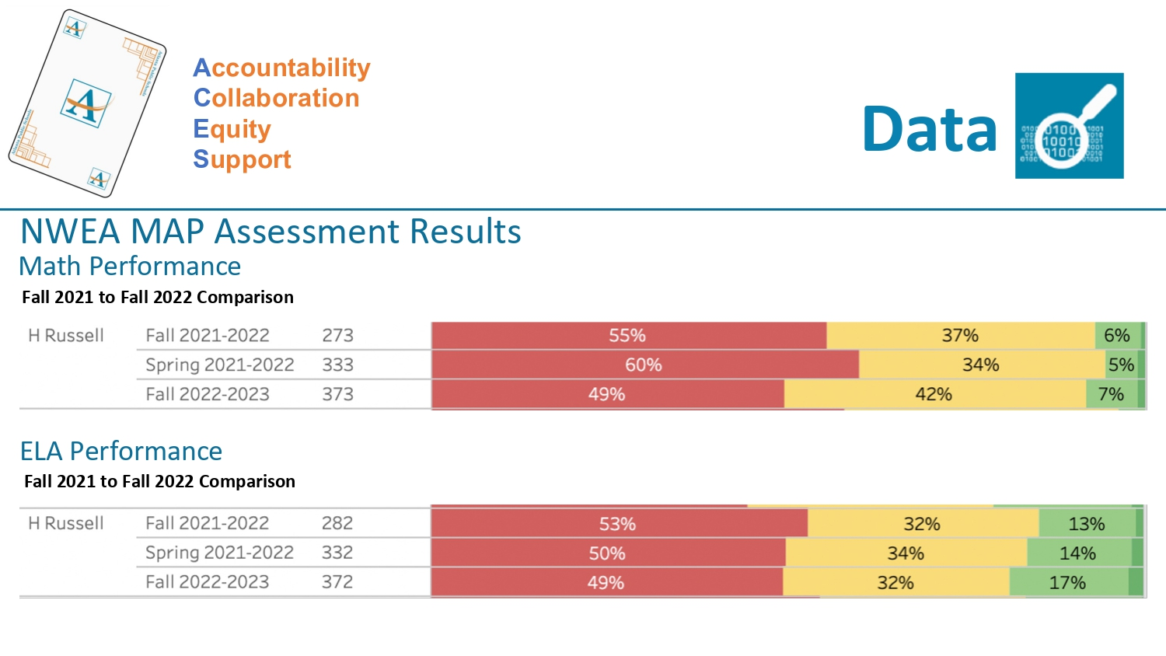

Slide 12
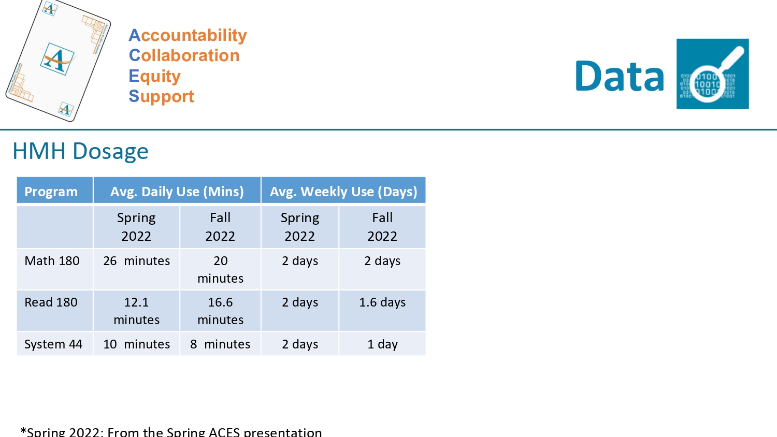

Slide 13
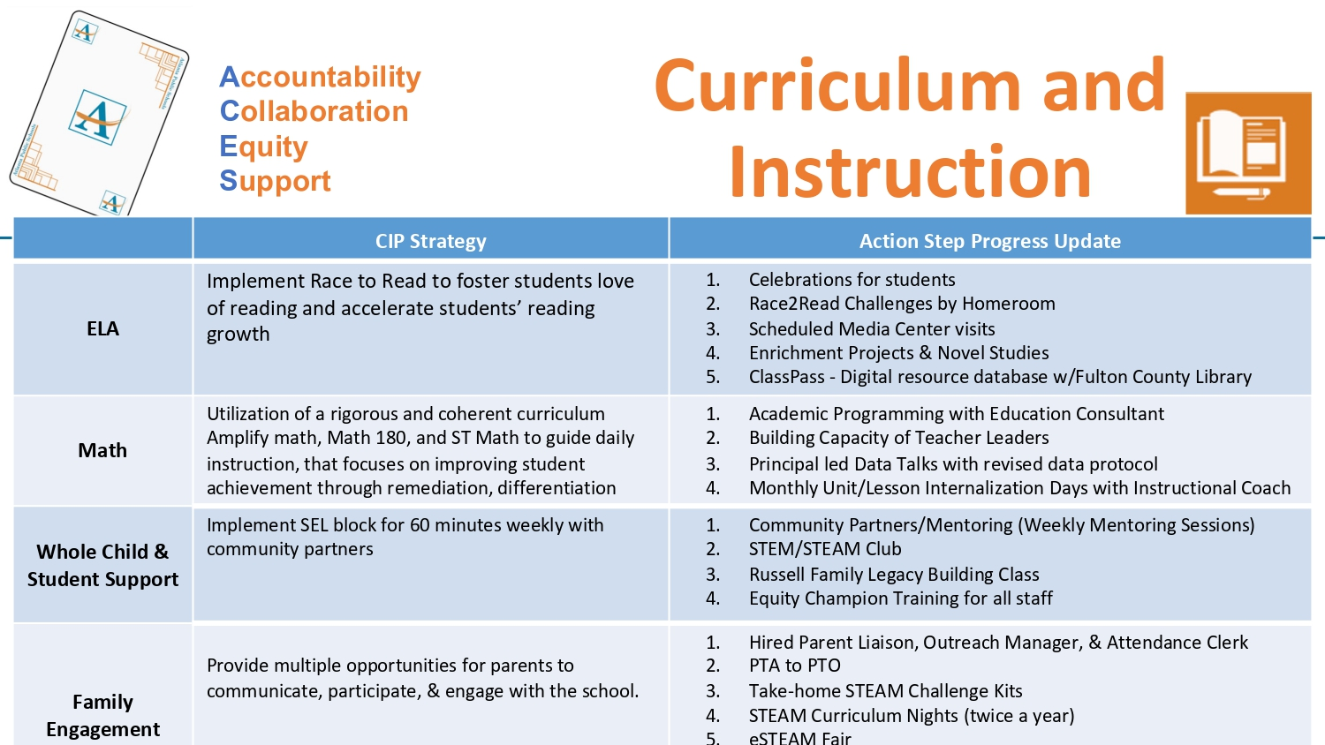

Slide 14


Slide 15
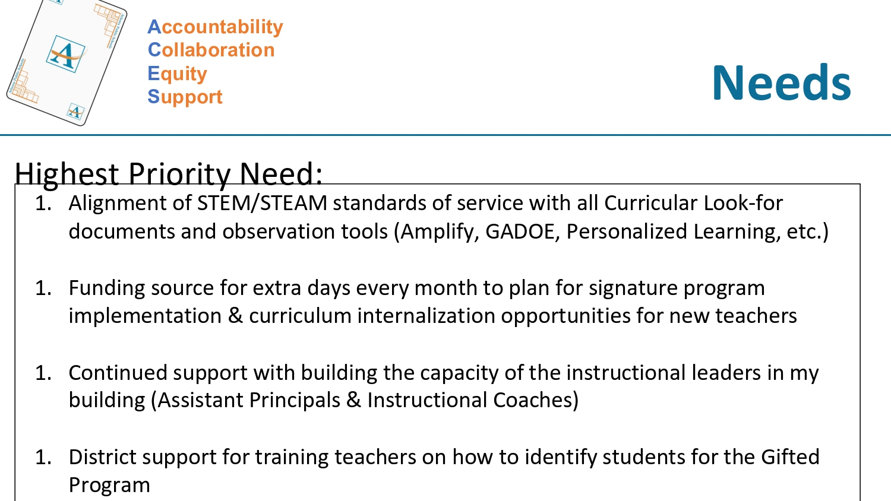

Slide 16
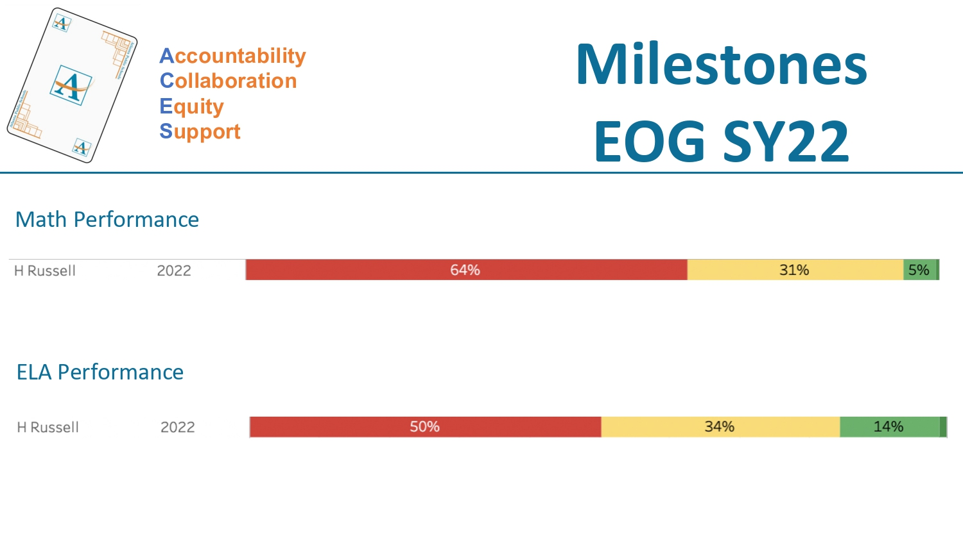

Slide 17
Strategic Plan Progress

Slide 18
Herman J. Russell West End Academy
Mission: We, the faculty, staff and community of Herman J. Russell West End Academy are committed to working together relentlessly as we strive to continuously improve student achievement creating a momentous impact where every child's unique gift is nurtured.
Vision: We envision a professional learning community dedicated and committed to providing the right teaching for our students to get the right learning at the right time.
SMART Goals
LITERACY
NUMERACY
WHOLE CHILD & STUDENT SUPPORT
By May 2023, we will Increase the percentage of Developing and Above Learners on the GA Milestones ELA EOG by: ​
5 percentage points from 43% to 48% Developing+ Learners (6th) ​
5 percentage points from 49% to 54% Developing+ Learners (7th) ​
5 percentage points from 47% to 53% Developing+ Learners (8th)
By May 2023, we will Increase the percentage of Developing and Above Learners on the GA Milestones Math EOG by: ​
5 percentage points from 26% to 31% Developing+ Learners (6th) ​
5 percentage points from 48% to 53% Developing+ Learners (7th) ​
5 percentage points from 35% to 40% Developing+ Learners (8th)
Increase ADA from 81% to 85% by May 2023
​
APS Strategic Priorities & Initiatives
School Strategic Priorities
School Strategies
1a. Implement with fidelity APS Instructional Practices and Units of Study with an emphasis on literacy and math
1b. Implement Lexile monitoring, vocabulary strategies, daily reading and writing, R.A.C.E. strategy and utilization of components of the writing rubric in all content areas including connections classes
1c. Use math manipulatives to move students from the concrete to the representational and abstract 1d. Incorporate a cumulative spiral review of computation skills to re-teach basic math concepts from previous grade levels as well as review on grade level standards.
2a. Increase the number of SWD students in the inclusion setting to ensure that the students receive standards based instruction in core content
2b. Increase the usage of instructional software to address the reading and math deficits of SWD students according to an individualized learning plan
3a. Create a STEM team comprised of the Principal, STEM Teachers-(Math, Science, Literacy and Technology) and Science/Math Instructional Coaches, STEM Support Specialist.
3b. Provide on-going professional development for STEM teachers
3c. STEM teachers work collaboratively to create and/or develop projects for STEM students
3d. STEM students given opportunities to compete in local, district and national STEM competitions
3e. Increase STEM students’ exposure to a unique and explicit curriculum (e.g. advanced academics, agriculture, biotechnology, computer programing engineering, and information technology)
Fostering Academic Excellence for All Data
Curriculum & Instruction Signature Program
Improve student mastery of core content knowledge (ELA/ Literacy, Math, Science & Social Studies)
Close the Student Achievement Gap with Regular Education Students and Students with Disabilities
Implement an effective STEM enriched curriculum to drive interdisciplinary and project-based teaching and learning approaches
Building a Culture of Student Support
Whole Child & Intervention Personalized Learning
Equipping & Empowering Leaders & Staff
Strategic Staff Support Equitable Resource Allocation
Foster a positive school culture through a collaborative, inclusive, and responsive school culture embracing the diverse communities and stakeholders that comprise the Herman J. Russell West End Academy family
1a. Create a shared responsibility and commitment among staff and HJRWEA stakeholders, to the vision and mission of the school.
1b. Create an environment where students and staff are engaged through an understanding and application of their strengths.
1c. Implement Social and Emotional Learning (SEL) for students and staff to foster an environment of academic success and positive reinforcement (e.g. anti-bullying/cyber bullying forums, character ed., community service)
1d. Create opportunities for staff to participate in professional development which aligns with our PBIS/SEL initiative (Mindset/ De-escalation Training)
1e. Create additional student clubs and organizations that merges with S.T.E.A.M (Science, Technology, Engineering, Arts and Mathematics) and athletics.
Creating a System of School Support
Strategic Staff Support
Equitable Resource Allocation
14

Slide 19
Herman J. Russell West End Academy
Mission: We, the faculty, staff and community of Herman J. Russell West End Academy are committed to working together relentlessly as we strive to continuously improve student achievement creating a momentous impact where every child's unique gift is nurtured.
Vision: We envision a professional learning community dedicated and committed to providing the right teaching for our students to get the right learning at the right time.
SMART Goals
LITERACY
NUMERACY
WHOLE CHILD & STUDENT SUPPORT
By May 2023, we will Increase the percentage of Developing and Above Learners on the GA Milestones ELA EOG by: ​
5 percentage points from 43% to 48% Developing+ Learners (6th) ​
5 percentage points from 49% to 54% Developing+ Learners (7th) ​
5 percentage points from 47% to 53% Developing+ Learners (8th)
By May 2023, we will Increase the percentage of Developing and Above Learners on the GA Milestones Math EOG by: ​
5 percentage points from 26% to 31% Developing+ Learners (6th) ​
5 percentage points from 48% to 53% Developing+ Learners (7th) ​
5 percentage points from 35% to 40% Developing+ Learners (8th)
Increase ADA from 81% to 85% by May 2023
​
APS Strategic Priorities & Initiatives
School Strategic Priorities
School Strategies
1. Prepare and develop knowledgeable staff focused on quality teaching
2. Build teacher capacity in core content areas (ELA, Math, Science & Social Studies)
3. Recommend high-quality staff for vacant positions
1. Provide instructional resources (personnel, time, and technology, and materials) to support teacher efficacy and student achievement through professional learning and monitoring.
2. Provide high quality job embedded professional learning regarding Standards Based Instruction, APS Definition of Teacher Excellence and Mathematical Practices.
3a. Recruit and retain high quality teachers who contributes in student’s extra-curriculum activities beyond the school day ( e.g. mentorship opportunities, athletic coaches, club/organization sponsors)
3b. Check professional references and look at previous student performance data, if applicable
3c. Model a lesson as a component of the interview
Equipping & Empowering Leaders & Staff
Strategic Staff Support Equitable Resource Allocation
Creating a System of School Support
Strategic Staff Support
Equitable Resource Allocation
1a. Build and align systems and resources to identify and address root causes to promote social and academic growth
1b. Build systems and resources to support core academics and STEM implementation
2. Outreach and community partners, families, etc. attending family engagement events and meetings (Cluster meetings, Parent University, and other Family Engagement Events led by Parent Liaison
1. Ensure systems and resources are aligned to school priorities
2. Increasing opportunities for parental involvement
14

Slide 20
Activity & Discussion
Review the priorities and goals in your strategic plan and reflect on if the expected progress is being made. These guiding questions will help you determine what, if any, updates are needed for your school’s strategic plan.
Are all CIP Goals reflected in our Strategic Plan Priorities? If not, which CIP Goal(s) are missing and should be added to the Strategic Plan?
  Yes, all are reflected in the strategic priorities.
What progress has been made towards the priorities identified in our Strategic Plan? What evidence/data do we have?
Students doing the heavy-lifting (student accountability)
Intervention time addresses Math and ELA deficiencies
Data Talks -HMH, MAP, Lexile Scores
Hiring quality staff to fill vacancies
Attendance/CARE team - incentives to decrease suspensions and encourage attending school
Monitoring by administration - student/staff accountability
Based upon available data, are there any other adjustments we need to make to the Strategic Plan?
  Add to Strategic Priorities and Strategies: family engagement opportunities

Slide 21
Updates to the
Strategic Plan
Increasing opportunities for parental involvement
  Outreach and community partners, families, etc. attending family engagement events and meetings (Cluster meetings, Parent University, and other Family Engagement Events led by Parent Liaison)

Slide 22
Questions?
Wonderings?
Comments?

Slide 23
Preparing for
Budget Development

Slide 24
You are HERE
1
2
3
4
5
1
2
3
4
5
Fall 2021
GO Team Developed 2021-2025 Strategic Plan
Summer 2022
School Leadership completed Needs Assessment and defined overarching needs for SY22-23
August 2022
School Leadership completed 2022-2023 Continuous Improvement Plan
Sept. – Dec. 2022
Utilizing current data, the GO Team will review & update the school strategic priorities and plan, as needed
Before Winter Break
GO Team will take action (vote) on the school’s strategic plan and vote on the ranked strategic plan priorities for SY23-24 budget discussions.

Slide 25
Action on the Updated Strategic Plan
The GO Team needs to TAKE ACTION (vote) on its updated Strategic Plan. After the motion and a second, the GO Team may have additional discussion. Once discussion is concluded, the GO Team will vote.

Slide 26
Discussion
Strategic Plan Priority Ranking
In preparation for the 2023-2024 Budget Development (January–March 2023), the GO Team needs to rank its Strategic Plan Priorities. Use the next slide to capture the priority ranking.

Slide 27
Strategic Plan
Priority Ranking
  Improve student mastery of core content knowledge (ELA/ Literacy, Math, Science & Social Studies)
  Close the Student Achievement Gap with Regular Education Students and Students with Disabilities
  Implement an effective STEM enriched curriculum to drive interdisciplinary and project-based teaching and learning approaches
  Foster a positive school culture through a collaborative, inclusive, and responsive school culture embracing the diverse communities and stakeholders that comprise the Herman J. Russell West End Academy family
  Prepare and develop knowledgeable staff focused on quality teaching
  Build teacher capacity in core content areas (ELA, Math, Science & Social Studies)
  Recommend high-quality staff for vacant positions
  Ensure systems and resources are aligned to school priorities
  Increasing opportunities for parental involvement
Insert the school’s priorities from Higher to Lower
Higher
Improve student mastery of core content knowledge (ELA/ Literacy, Math, Science & Social Studies)
Prepare and develop knowledgeable staff focused on quality teaching
Build teacher capacity in core content areas (ELA, Math, Science & Social Studies)
Recommend high-quality staff for vacant positions
Implement an effective STEM enriched curriculum to drive interdisciplinary and project-based teaching and learning approaches
Foster a positive school culture through a collaborative, inclusive, and responsive school culture embracing the diverse communities and stakeholders that comprise the Herman J. Russell West End Academy family
Close the Student Achievement Gap with Regular Education Students and Students with Disabilities
Ensure systems and resources are aligned to school priorities
Increasing opportunities for parental involvement
Lower

Slide 28
Action on the Strategic Plan Priorities
The GO Team needs to TAKE ACTION (vote) on its ranked Strategic Plan Priorities. After the motion and a second, the GO Team may have additional discussion. Once discussion is concluded, the GO Team will vote.

Slide 29
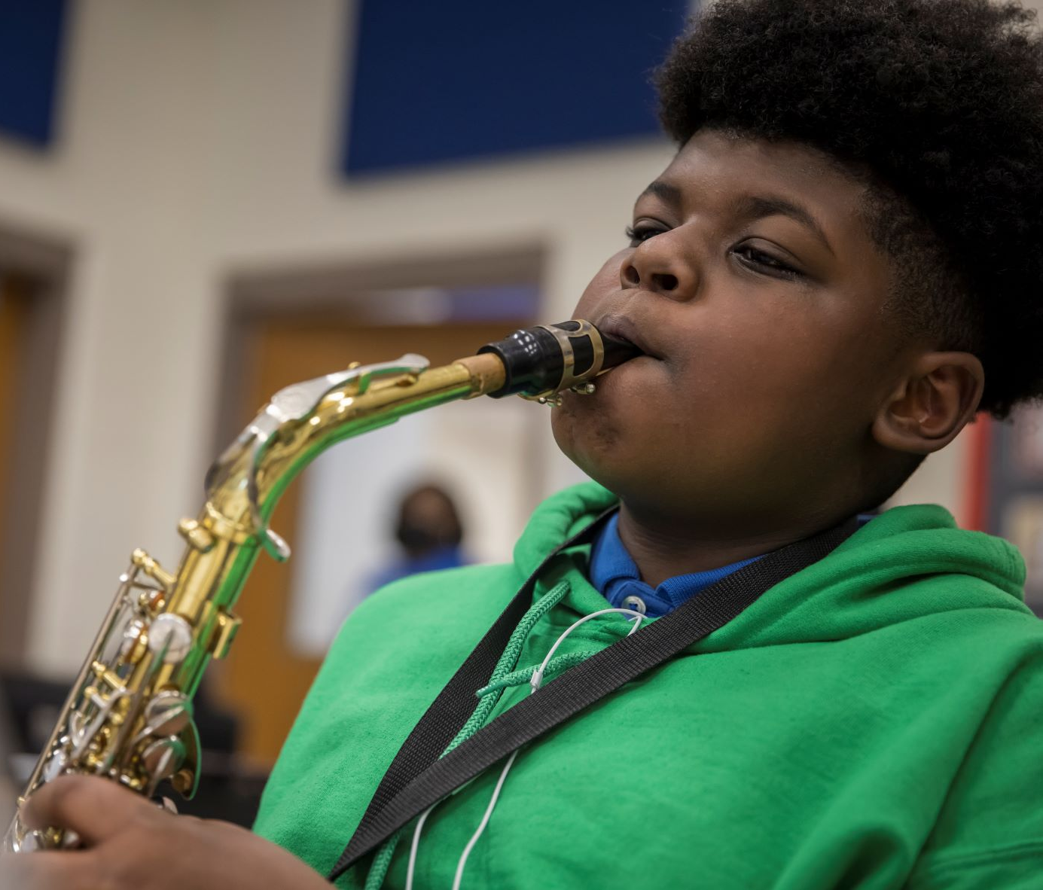

Where we’re going
At our next meeting(s) we will begin the discussion of the 2023-2024 budget.
Let me or the Chair know of any additional information you need for our future discussion.

Slide 30
Thank you

